Slide 1
CA – project
Make LC-2K Assembler , Simulator

Slide 2
What is LC-2K?
Very simple but enough to solve problem.
Has a 8 register
32-bit computer
65536 word-memory
All addresses are Word-addresses
NOTE : reg 0 always contain 0.

Slide 3
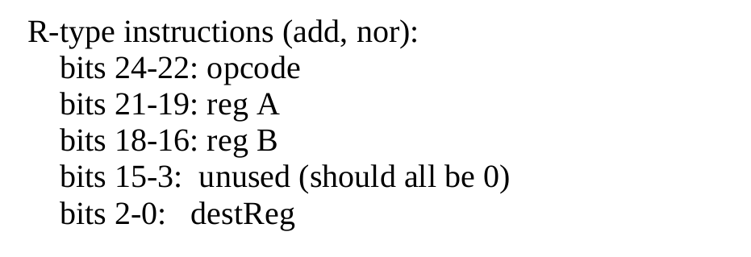
LC-2K ISA
R-Type

Slide 4
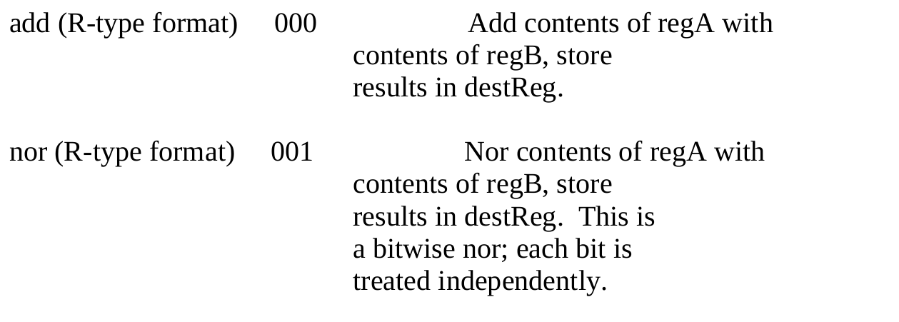
LC-2K ISA

Slide 5
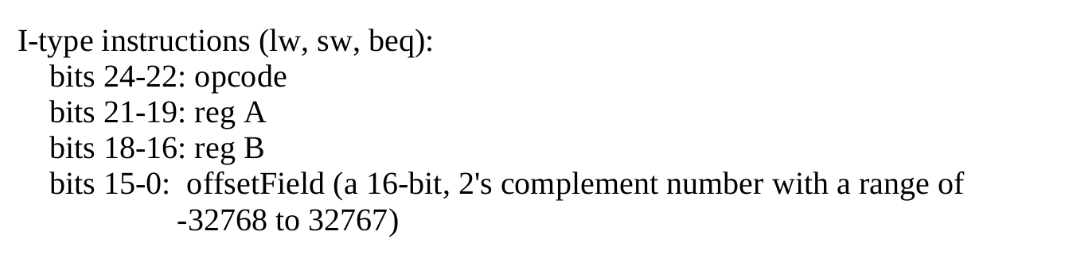
LC-2K ISA
I-Type

Slide 6
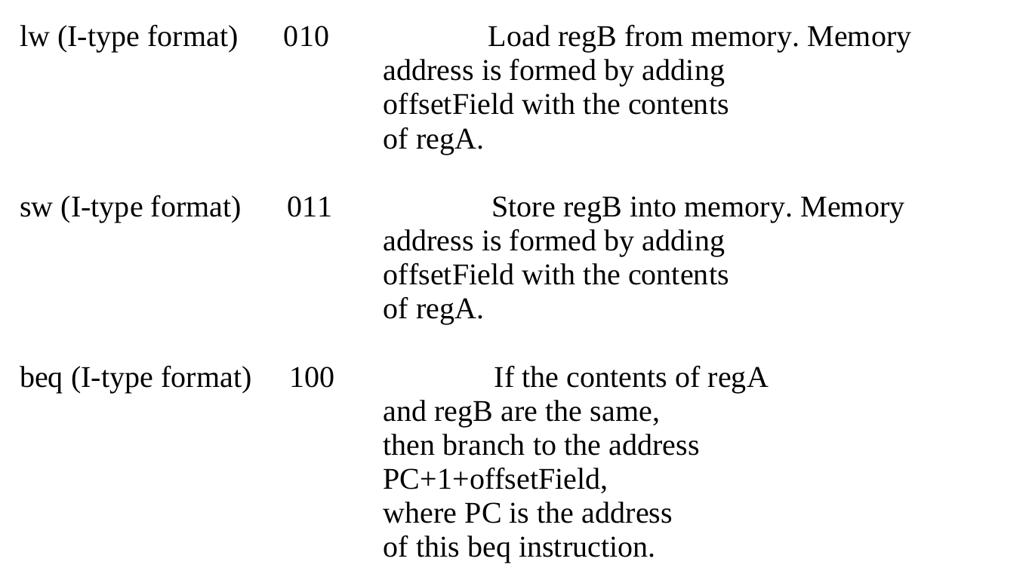
LC-2K ISA

Slide 7
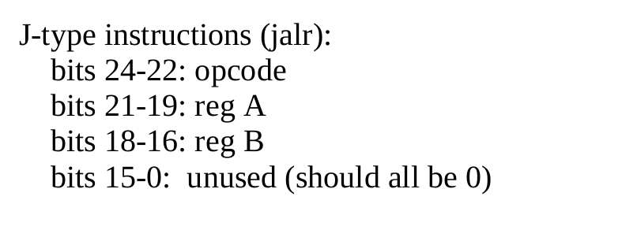
LC-2K ISA
J-Type

Slide 8
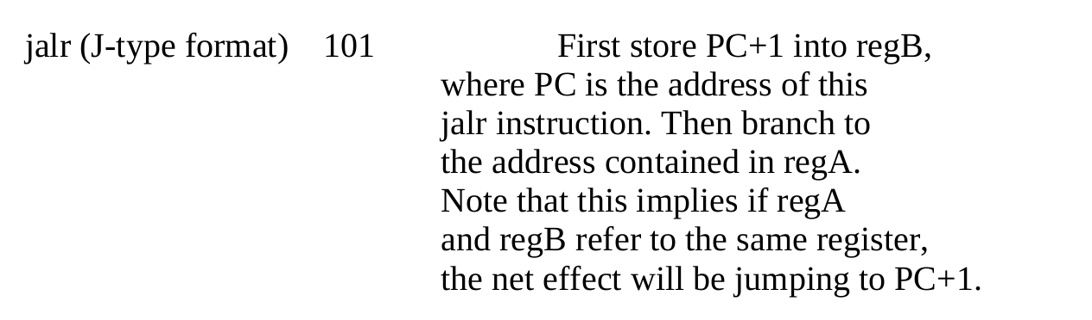
LC-2K ISA

Slide 9
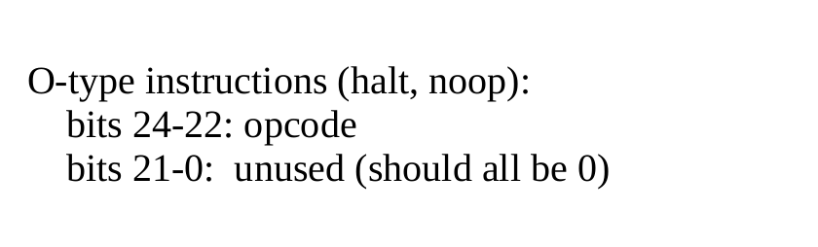
LC-2K ISA
O-Type

Slide 10
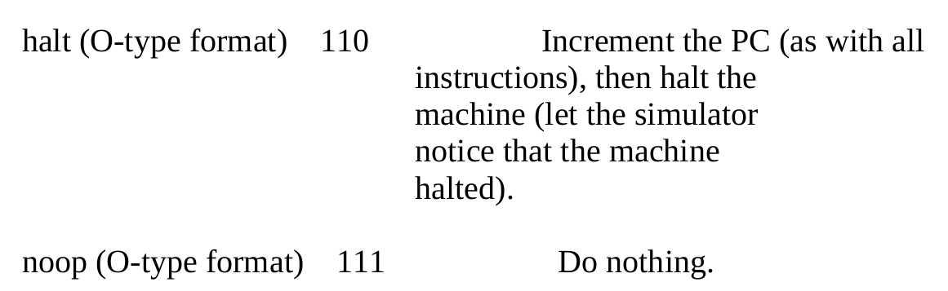
LC-2K ISA

Slide 11
LC-2K
Make Assembler (40%)
Make Simulator (40%)
Multiplication (20%)

Slide 12
1. Make Assembler
Write program to take an assembly-language and translate it into machine code.
And you need to translate symbolic name for address into numeric Values

Slide 13
Assembly Format
Label<white>instruction<withe>field0<white>field1<white>field2<white>comments

Slide 14
Assembly Format
Label is Optional (the white space following the label field is required)
Label’s name has a maximum 6 char and can consist of letters and number but first character must be letter
Unused field should be skip.

Slide 15
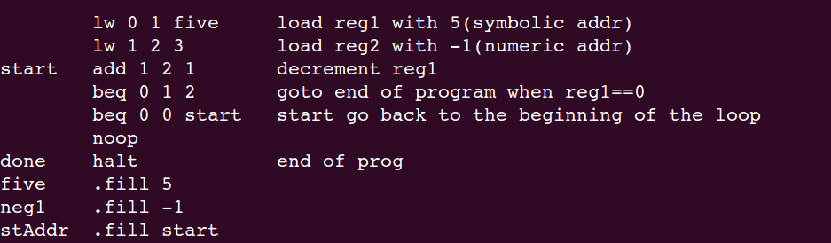
Symbolic Address
Symbolic address == label , so assembler should compute offset-Field to be equal to the address of the label
.fill →tells the assembler to put a number into the place where the instruction would normally be stored.

Slide 16
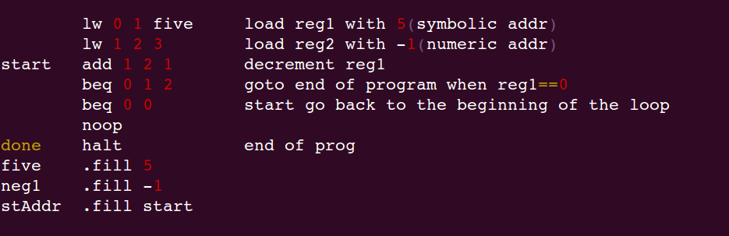
Make Assembler
Assembler
Machine Code.

Slide 17
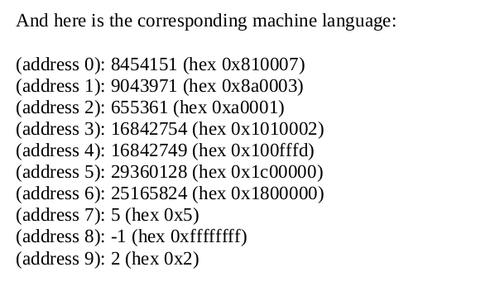
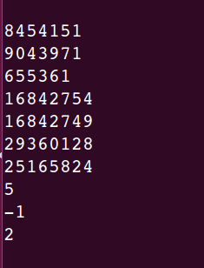
test.as
My_Assembler test.as test.mc
test.mc

Slide 18
Make Assembler
lw 0 1 five →00..00 010 000 001 0000000000000111 → 8454151
Unuse op regA regB offset-field
lw 1 2 3 →00..00 010 001 010 0000000000000011 → 9043971
Unuse op regA regB offset-field
Add 1 2 1→00..00 000 001 010 00000000000000 01 → 655361
Unuse op regA regB Unuse dest-reg

Slide 19
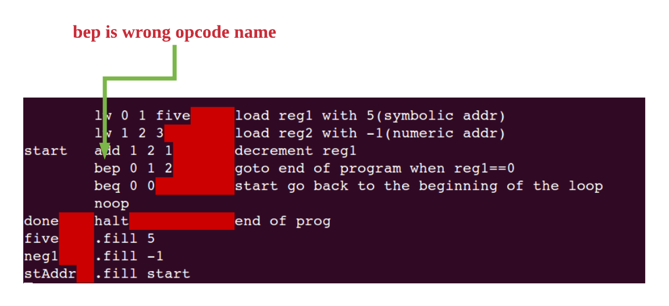
Make Assembler
NOTE : implement Error Check

Slide 20
Make Simulator
./Sim test.mc > Result
Each program counter(PC) , display memory, reg state , and PC
When initializing simulator , register and PC should be Zero.
And stop when meet halt Inst.

Slide 21
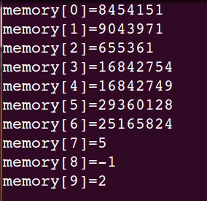
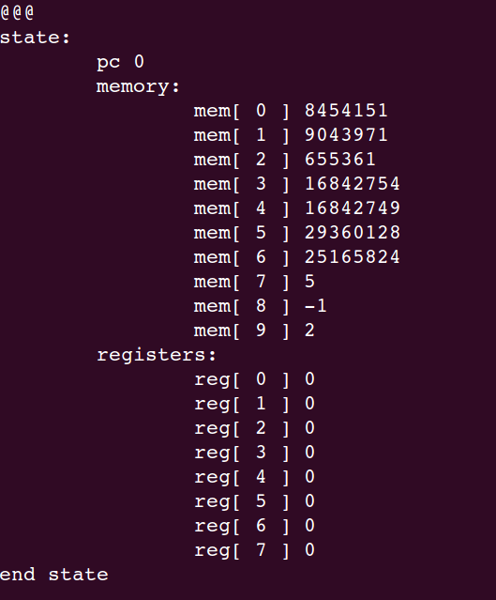
Make Simulator
Result
test.mc
./sim test.mc > Result

Slide 22
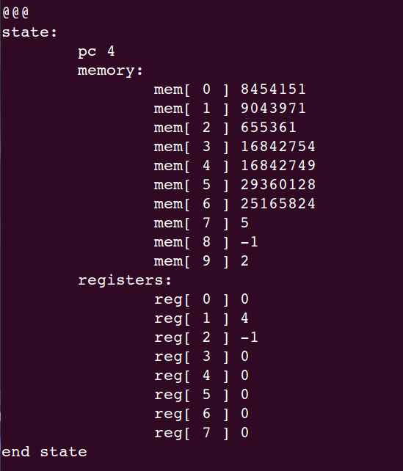
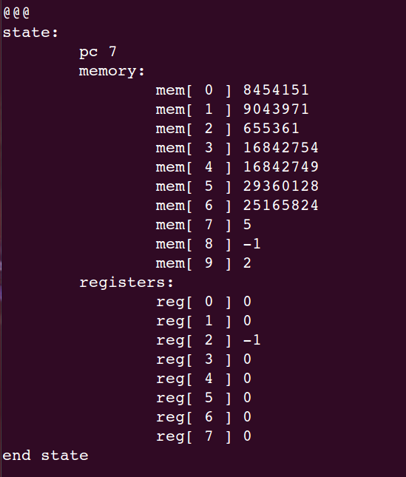
Make Simulator

Slide 23
Make Multiplication
Write Assembly language program to multiply two number ( 32766 * 10838 ).
Input Number by reading memory loaction (Label) called “mcand” and “mplier”.
The result should be stored in reg1 when program halt
Note : two input number are at most 15bits and positive number.
For efficient , it must be line <= 50 and Inst <= 1000

Slide 24
More Info
alpha930@naver.com -최경환
ITBT 701

